Slide 1
Prokaryotic Showdown Faulty Complex
Abdul Aaquib – Team Leader
Heidi Haack – Documentation and Presentation
John Taylor - Coding
Mitchell McClish - Testing
Sri Ram Padavala – Art and Audio

Slide 2
Game Concept
2-4 players
Play as bacteria, expand and reproduce
Purchase items to boost your growth or hamper your opponents
Turn-based growth

Slide 3
Functional Minimum
One level
One bacterium race
Multiplayer
Items that can be purchased and used
Point increase based on growth rate

Slide 4
Desired Target
Multiple levels that can be chosen or randomized
Multiple bacterium races that can be chosen or randomized
Functional store

Slide 5
High Target/Extras
Can’t see enemy movement or growth outside of a certain range of the closest unit
Have an interesting backdrop
Persistent profiles with levels/minor upgrades

Slide 6
Audience
Platform – PC
ESRB – E
Target Audience – Age 13+

Slide 7
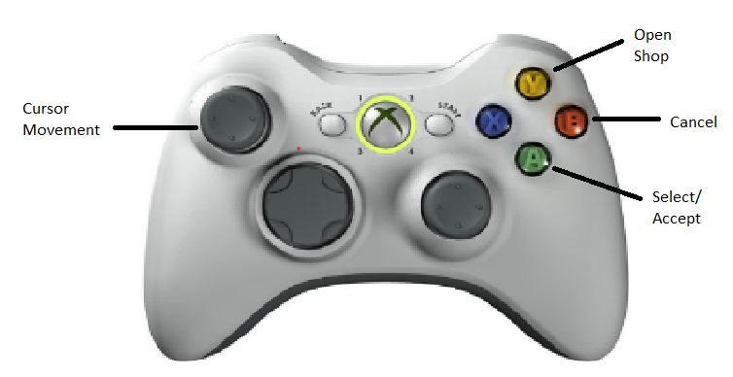
Controller Schema

